Slide 1

ABC Call Volume Trend Analysis
Presenter Name – Ayush Saxena

Slide 2


Outline
Introduction
Tech-Stack
Approach
Dataset Info
Questions
Conclusion
Thank You

Slide 3

Project Description
A customer experience (CX) team consists of professionals who analyze customer feedback and data and share insights with the rest of the organization. Typically, these teams fulfill various roles and responsibilities such as Customer experience programs (CX programs), Digital customer experience, Design and processes, Internal communications, Voice of the customer (VOC), User experiences, Customer experience management, Journey mapping, Nurturing customer interactions, Customer Success, Customer support, Handling customer data, Learning about the customer journey.
Customer support is defined as the call center which is responsible for handling inbound calls of customers. Inbound calls are the incoming voice calls of the existing customers or prospective customers for your business which are attended by customer care representatives. Inbound customer service is the methodology of attracting, engaging, and delighting your customers to turn them into your business' loyal advocates. By solving your customers' problems and helping them achieve success using your product or service, you can delight your customers and turn them into a growth engine for your business
Calculate the average call time duration for all incoming calls received by agents (in each Time Bucket)
Show the total volume/ number of calls coming in via charts/ graphs [Number of calls v/s Time]. You can select time in a bucket form (i.e. 1-2, 2-3, …..
As you can see current abandon rate is approximately 30%. Propose a manpower plan required during each time bucket [between 9am to 9pm] to reduce the abandon rate to 10%. (i.e. You have to calculate the minimum number of agents required in each time bucket so that at least 90 calls should be answered out of 100.)
Let’s say customers also call this ABC insurance company in night but didn’t get answer as there are no agents to answer, this creates a bad customer experience for this Insurance company. Suppose every 100 calls that customer made during 9 Am to 9 Pm, customer also made 30 calls in night between interval [9 Pm to 9 Am] and distribution of those 30 calls are as follows:

Slide 4


Tech-Stack Used
▪Filters
▪Excel Formulas
▪Pivot tables
▪Charts
▪Graphs
▪Functions

Slide 5



Approach
The very first task is to understand the dataset and its columns
After understanding the data, we have Clean the data as per the requirement.
We have removed the outliers and noise from the dataset.
Then we have Created the Pivot Tables and charts.
Then I worked on it by applying suitable aggregation.

Slide 6
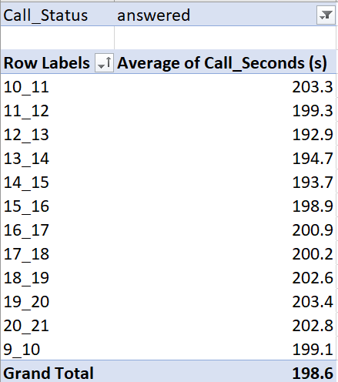
Calculate the average call time duration for all incoming calls received by agents (in each Time_Bucket)
Average call seconds time for all answered calls is 198.6 seconds.

Slide 7
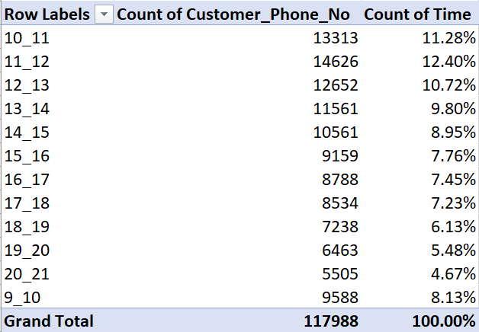
Show the total volume/ number of calls coming in via charts/ graphs [Number of calls v/s Time]. You can select time in a bucket form (i.e. 1-2, 2-3, …..
It is seen that count of time is most in 11-12 and it also been seen that in noon it is decreased
It is clearly seen that maximum count of customer calls is in the slot 11-12.

Slide 8
Percentage per time bucket

Slide 9
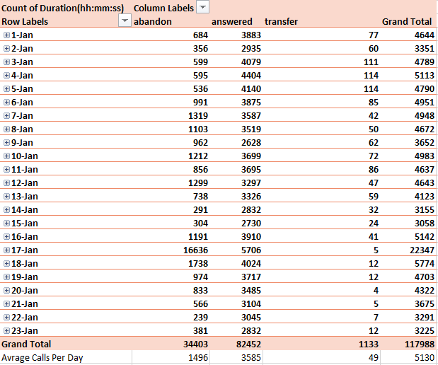
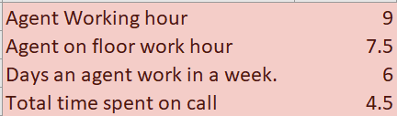
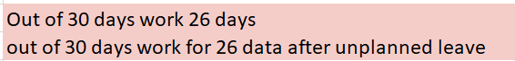
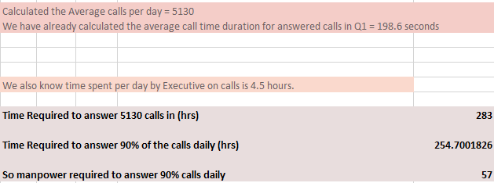
As you can see current abandon rate is approximately 30%. Propose a manpower plan required during each time bucket [between 9am to 9pm] to reduce the abandon rate to 10%. (i.e. You have to calculate the minimum number of agents required in each time bucket so that at least 90 calls should be answered out of 100.)

Slide 10
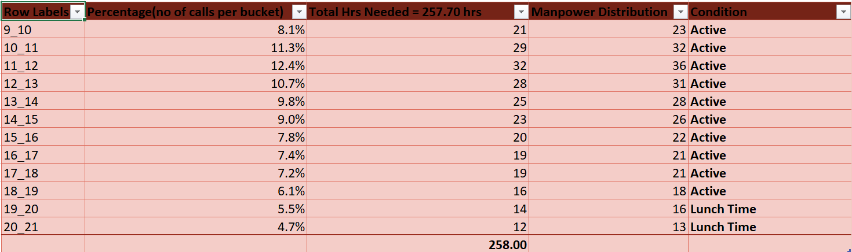
To achieve the 90 percent attend rate in Day Time
Lunch time is also given during that time when the engagement of customer is the low.

Slide 11
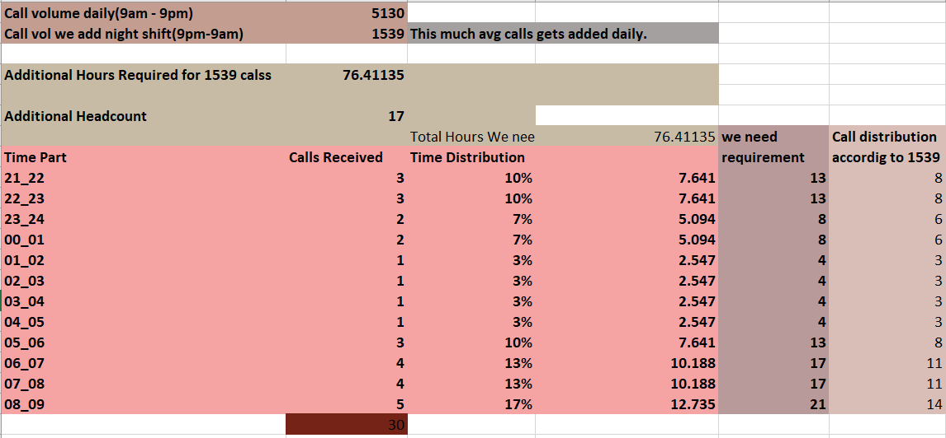
Let’s say customers also call this ABC insurance company in night but didn’t get answer as there are no agents to answer, this creates a bad customer experience for this Insurance company. Suppose every 100 calls that customer made during 9 Am to 9 Pm, customer also made 30 calls in night between interval [9 Pm to 9 Am] and distribution of those 30 calls are as follows:
Achieve the 90 % attend rate in night also

Slide 12
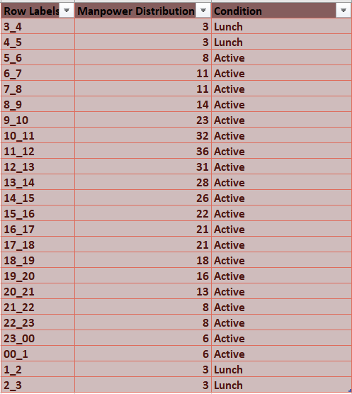
Now we have proposed a manpower plan required during each time bucket in a day. The maximum Abandon rate assumption would be the same 10%.

Slide 13

Conclusion
We have analyze the data of ABC Call Volume Trend Analysis, and we have extracted all the insights from the data that were asked by the team.
We have given the insights of these question that were very much prompt for the ABC Call Volume Trend Team for the future product management.
In this analysis we have deal with the time bracket and the scope of better in future customer connect.
Learn how the analysis the call volume trend and how can it perform better.

Slide 14

Thank You
Ayush Saxena
Email – ayushsaxenamasai@gmail.com
Google drive link - https://docs.google.com/spreadsheets/d/1bG9sD60pQZzPcMeZnpI1dH9WWHe2Xw-U/edit?usp=sharing&ouid=112242556178831629185&rtpof=true&sd=true

